Slide 1
Dissertation and Viva
PROM02: Computing Master’s Project
Dr Becky Allen
Becky.allen@sunderland.ac.uk

Slide 2

Our Objectives
In the session we will cover:
The Dissertation:
Dissertation layout and structure
What each chapter entails
The Viva:
Presentation
Demo
Q&A
General viva guidance

Slide 3
Dissertation
PROM02

Slide 4
Assessment 2: Dissertation – 75%
Your dissertation must represent both the practical and research elements of your project
It should be clear how the current research in the field has influenced your practical work
It must be clear how your project relates to your programme of study
Word limit – 15,000
References and figures (e.g. diagrams, screenshots, charts) are outside of the word count
Additional should be provided in the appendices
You should refer to this where relevant in your dissertation

Slide 5
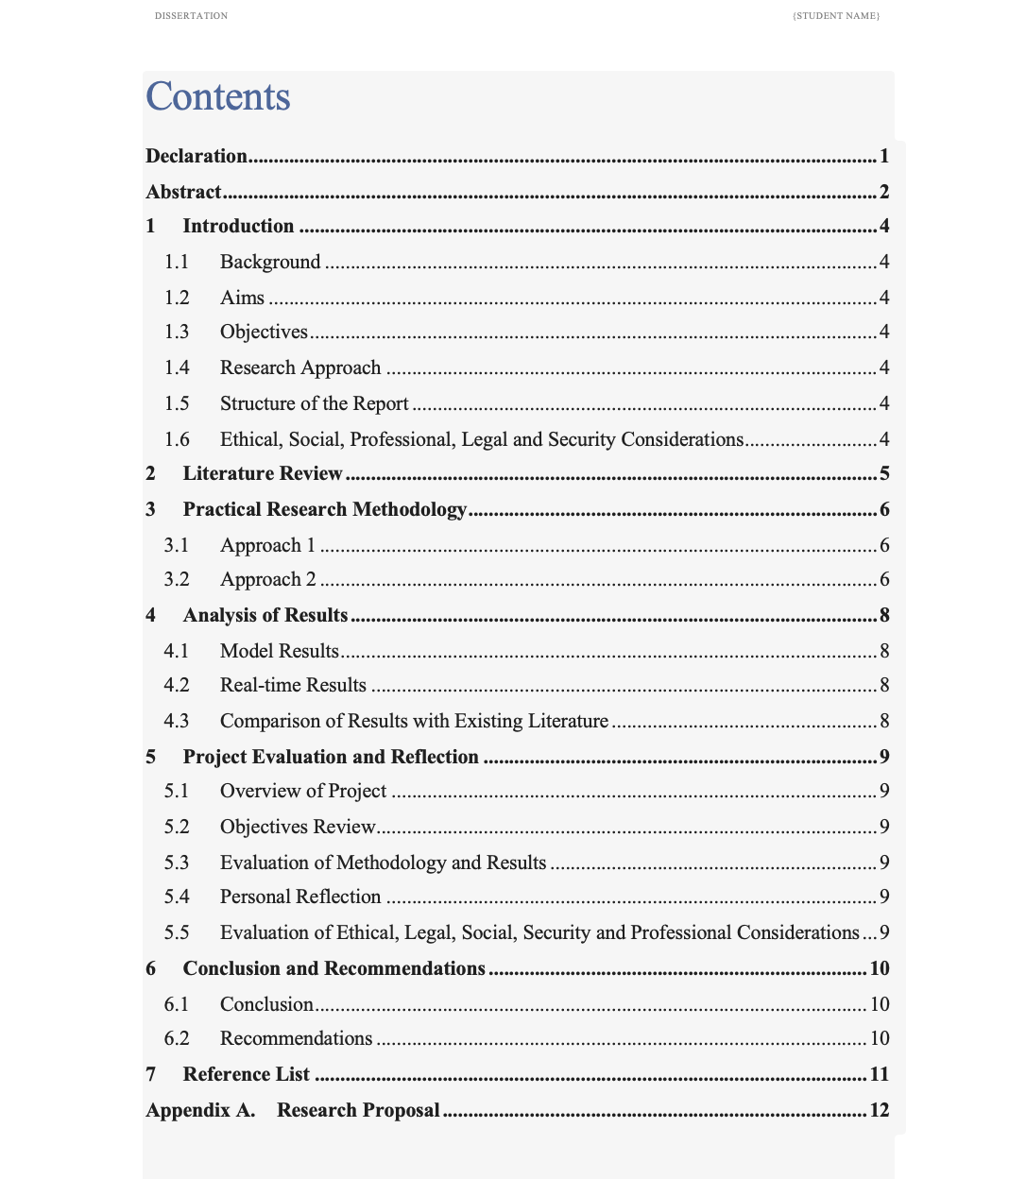
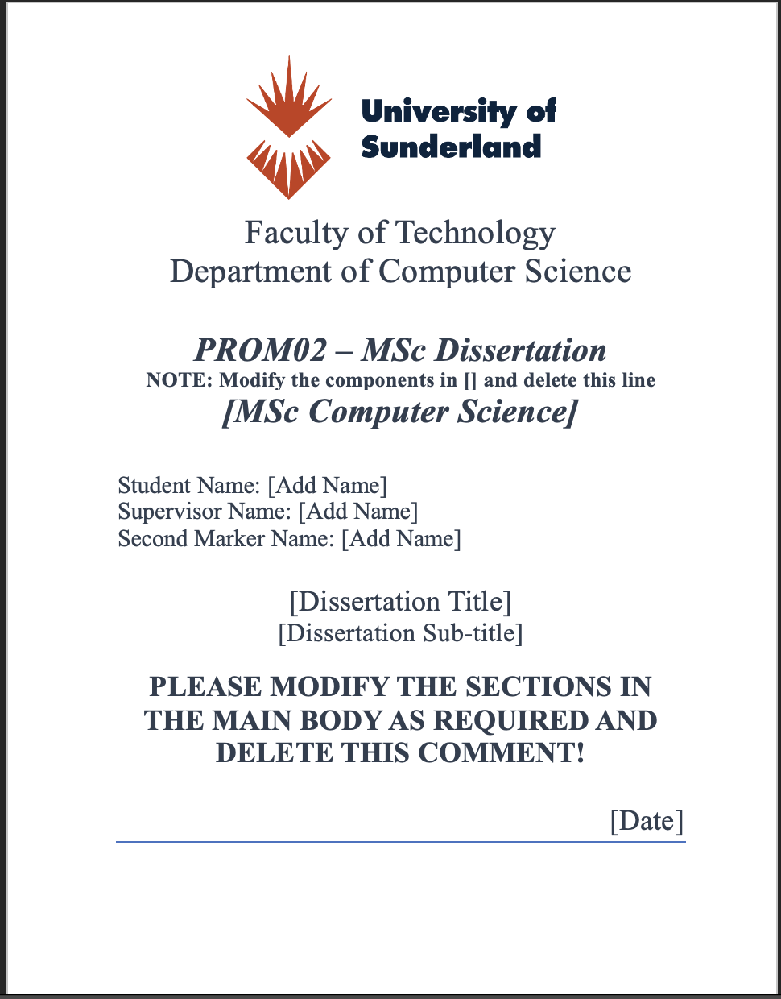
Dissertation Template on Canvas
In the Dissertation assessment portal
In the files to download section of the lecture
IMPORTANT!
This must be modified to appropriately match your project

Slide 6
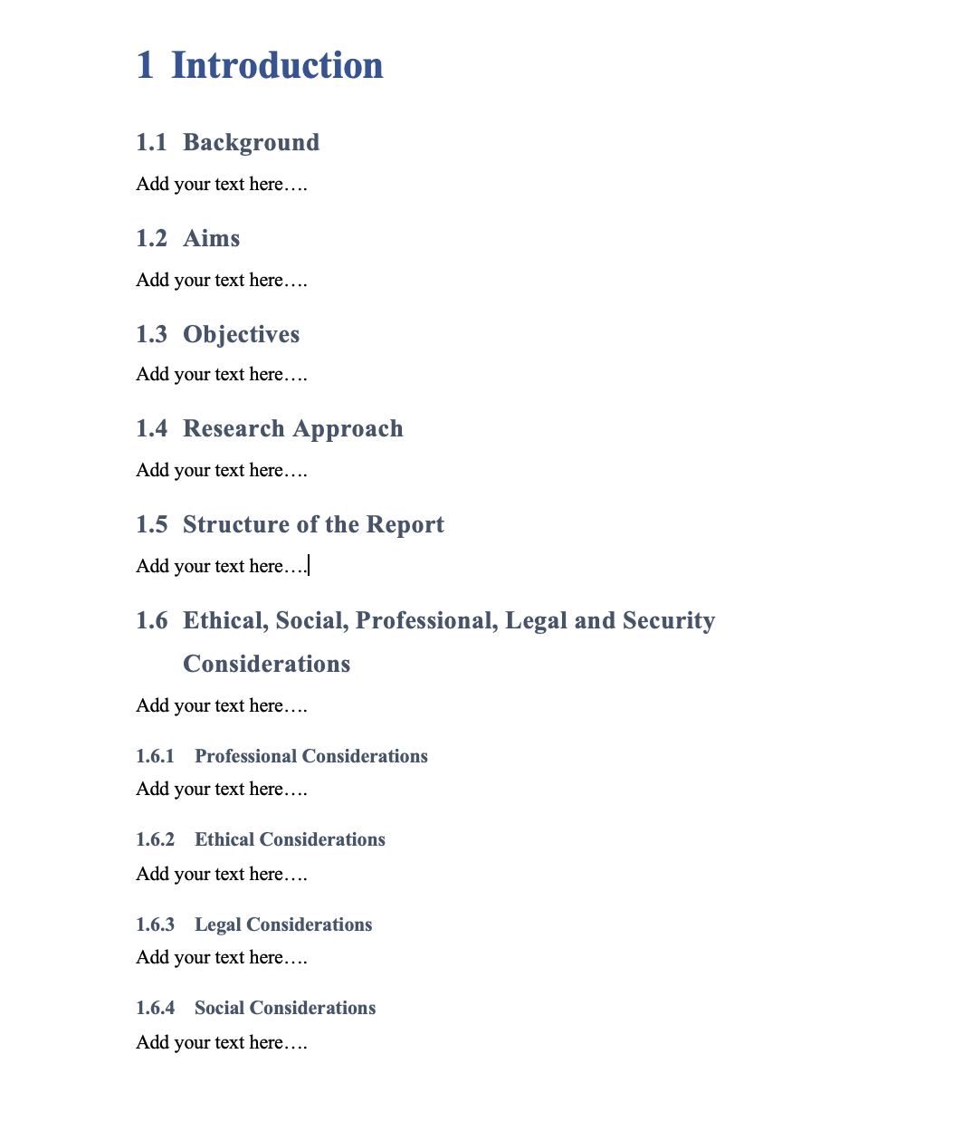
Dissertation Layout
The main text of the dissertation should be divided into numbered chapters
Each with a clear title
Each chapter should have a series of headings and sub-headings
The headings should follow a logical order
The text should flow from one section to the next

Slide 7
References
This should be a list of sources that have been referenced in the main body of the dissertation
You should use Harvard Referencing System
Example of in text citation:
... according to findings by Benedict et al. (2021) ...
Example of reference list:
Benedict, A. (2021) ’Defining Deep Learning,’ IEEE Transactions on Artificial Intelligence, 210(7), pp.103-110. doi: 00.001.000x.

Slide 8

Dissertation Structure
Your dissertation should cover (but is not limited to) the following elements:
TITLE PAGE
DECLARATION
ABSTRACT
CONTENTS PAGE
LIST OF FIGURES
Introduction
Literature Review
Practical Work
Results, Analysis and Evaluation
Project Evaluation
Conclusions and Recommendations
REFERENCES
APPENDICES

Slide 9
Dissertation Structure – Abstract
The Abstract should be a single paragraph of 200 – 250 words summarizing the project.
It should include the following:
Motivation for the project
Research aim / hypothesis
Research approach
Key findings
Conclusions
The aim of the Abstract is to inform the reader of the key elements of the project
You should write the Abstract last after all other chapters

Slide 10
Dissertation Structure – Introduction
IMPORTANT!
The Introduction is usually written in stages as you carry out the project
The Introduction should introduce the main report.
It should include a short discussion on each of the following:
Background / Motivation for the project
Research Aim / Hypothesis / Research Question
Research Objectives (SMART) – should demonstrate the steps required to meet your research aim or answer your research question.
Planned research approach
Structure of the report
SEPLi (Social, Ethical, Professional, Legal issues)
It should not discuss the main results and conclusions from the research project.
The two main functions of the Introduction are to introduce the main ideas and approach for the research project and signpost the reader to the relevant chapters.

Slide 11

Dissertation Structure – Literature Review
The Literature Review should consist of a careful selection of relevant papers and a critical review and evaluation of these.
It should follow a logical structure
Should provide a coherent argument and background to your proposed study.
The research aim / hypothesis should be the natural conclusion of the literature review.
It should be clear from your Literature Review why your research aim is worth investigating.

Slide 12
Approaching the task of reading
Guidance: Efficient Reading of Papers in Science and Technology
http://www.cs.columbia.edu/~hgs/netbib/efficientReading.pdf
Different types of reading/reading processes:
Close reading
Skim-reading
Assimilating what you read
Distinguishing main points from secondary points
Predicting
Scanning
Reading at speed
etc

Slide 13
Reading, thinking and writing critically
Critical reading - careful, active, reflective, analytic reading, in which you discover information and ideas within a text
But discovering new information is not enough!
Critical thinking - reflecting on the validity of what you have read in light of prior knowledge and understanding (comparing against other research)
This is ‘taking it to the next stage’
Critical writing – putting the thinking stage onto paper effectively

Slide 14
Deciding on your research chapter’s structure
Consider whether you are going to:
Compare & contrast 2 or more theories/developments
Place theories/developments into historical or technical-developmental context
Take issue with the various theories, pointing out their limitations
Consider whether you are writing as an authority with a strong opinion or whether you are ambivalent about the various theories

Slide 15
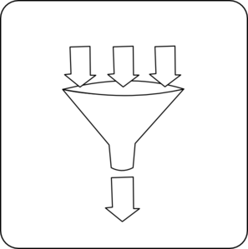
Funnel!
Broad topic, Definitions
Becoming
more
Focused
Very
focused
conclusions

Slide 16
Dissertation Structure – Practical Research Work
Chapters 3 and 4 should discuss the practical / technical aspects of your project.
If a significant product has been built then the dissertation should include a discussion of each stage of the product development life cycle, including:
Definition of requirements
Design of product
Implementation / build
Testing
Along with consideration of any tools and technologies used.

Slide 17
Dissertation Structure – Practical Research Work
Similarly, if your practical research work has consisted of experimental work, then these chapters should include a discussion of each stage of the experimental process including:
Definition of experimental variables and other requirements
Design of experiments
Implementation
Collection of results
Along with consideration of any tools and technologies used, these chapters should also outline the choices made along the way with any alternatives considered and the reasons for those choices.
These chapters should also outline the key SEPLi considerations and HOW these have been addressed.

Slide 18
Dissertation Structure – Results, Analysis and Evaluation
The content of these chapter(s) depends on the nature of the project
Overall, the idea is to evaluate and discuss how well you have met the project aim and objectives.

Slide 19
Dissertation Structure – Results, Analysis and Evaluation
Development Type Project
Experimental Type Project
An analysis of to what extent the product created OR the method used to create the product meets evaluation criteria.
This chapter should discuss:
The choice of criteria
How the criteria were measured
The results
An analysis of the results of the experiments.
This chapter should discuss:
The results
Statistical significance of the results
Reliability of the results

Slide 20
Dissertation Structure – Results, Analysis and Evaluation
For studies involving qualitative data collection you should also discuss:
Analysis of the findings from the data
Consideration of the depth of the findings
Reliability
Significance
You also need to include in this chapter:
Anything that happened during the project which may have affected your main results or findings
How your findings contribute to the wider academic body of knowledge
Compare your results / findings with those studies included in your Literature Review

Slide 21
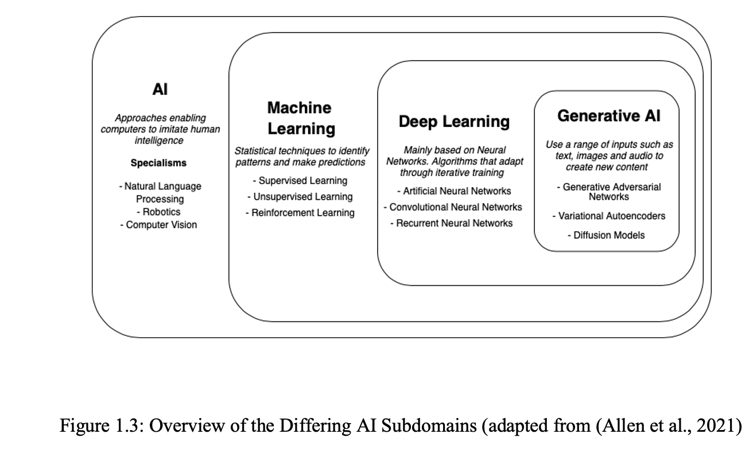
Presenting Results – Use of Figures and Code Snippets
Use of figures (diagrams, charts, plots, graphs etc.) is an effective way to demonstrate and open discussion of your results and findings.
Figures must be labelled and provided with a short title
If you are using an image or figure from a source this MUST be referenced.
You can include code snippets within your Dissertation, however these must use Courier font
Screenshots of code should be avoided.

Slide 22
Dissertation Structure – Project Evaluation
This chapter should evaluate two aspects:
The quality of the research
The journey you have gone through
For the research itself, consider:
How well was each objective met?
How successful was each stage of the project
How effective was the literature review? Is it possible that there were relevant techniques or issues that were ignored?
Were there alternative aims/hypotheses that could have been tested?
For developmental projects, what other evaluation criteria could have been considered?
For experimental studies, how complete were the experimental results; how reliable are the conclusions?
For more qualitative studies, how robust was the data collection and analysis; how reliable is the data and were there any limiting factors?

Slide 23
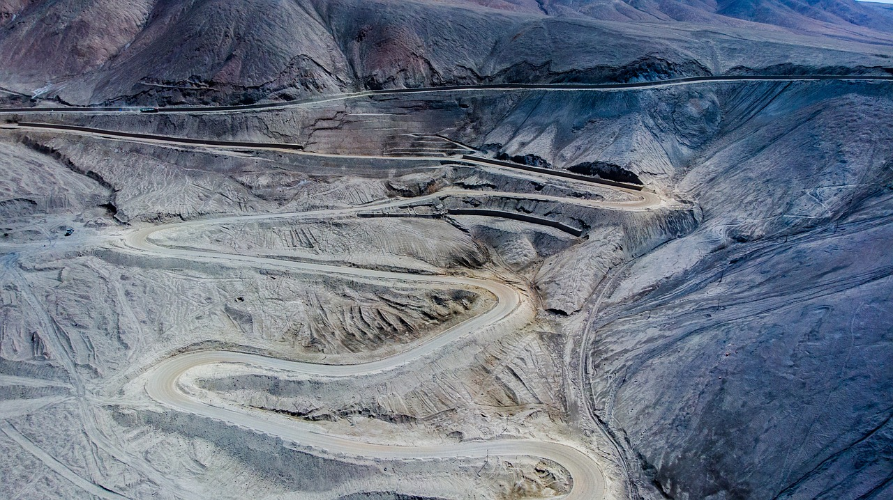
Dissertation Structure – Project Evaluation
For the learning journey, consider:
What have you learnt by doing the project? (Think about both ‘soft skills’ and technical skills)
What worked well?
What could you have improved?
How successful was your project management approach?
You should also evaluate the key social, ethical, professional and legal issues and HOW WELL you think you addressed these.

Slide 24
Dissertation Structure – Conclusions and Recommendations
The Conclusions should present the answer to the original research question
You should also discuss any other conclusions reached along your project journey
E.g. Best choice of tools or technologies
There should be no ‘surprises’ in this chapter
Each conclusion should have been noted and evidenced somewhere else in the dissertation
Recommendations should be included relating to:
Further research
Possible practical applications
Recommendations for future practice

Slide 25
Appendices
Included at a minimum:
Project Proposal form
Project Schedule (Planning Assessment – Tables 2.1, 2.2, 2.3, 2.4)
Supervision Meeting Log
Screenshot of Ethical Application Approval email
If you carried out any Qualitative data collection (e.g. questionnaire, semi-structured interview) the questions a copy of this MUST be included.
Additional evidence which can be included (must be cited in main text – e.g see A1):
Design documentation (wireframes, user interface mockups)
Code snippets
Correspondence with supervisor / client

Slide 26
Questions?

Slide 27
Viva
PROM02

Slide 28
Assignment 3: Viva – 15%
The Viva will consist of:
Presentation – between 10 – 15 minutes
Demonstration of technical work – 5 minutes
Questions – between 10 -15 minutes
The viva will be attended by your supervisor and second marker
At the discretion of your supervisor your viva may be held in person on Campus or via Teams
A time and data will be arranged between yourself and the supervisory team

Slide 29
Assignment 3: Viva – Presentation
The presentation section of the viva should last approximately 10-15 minutes
You should prepare a set of presentation slides (template on Canvas) with a maximum of 10 slides
These should present both your research and practical elements of your project
The slides should cover the following:
Introduction: providing overview for the listeners including purpose, relevance, importance, and objectives of the work you are presenting.
Context / Underpinnings: identifying how you used and applied the research literature and reviews you have undertaken within your research and practical work.
Practical Element: what your practical work involved and how you undertook it including how you applied and integrated research.
Outcomes, Results and Evaluation: how you answered your research question and your client/sponsor requirements through your practical work
Discussion: of outcomes, results, findings, limitations, potential extensions, etc.

Slide 30
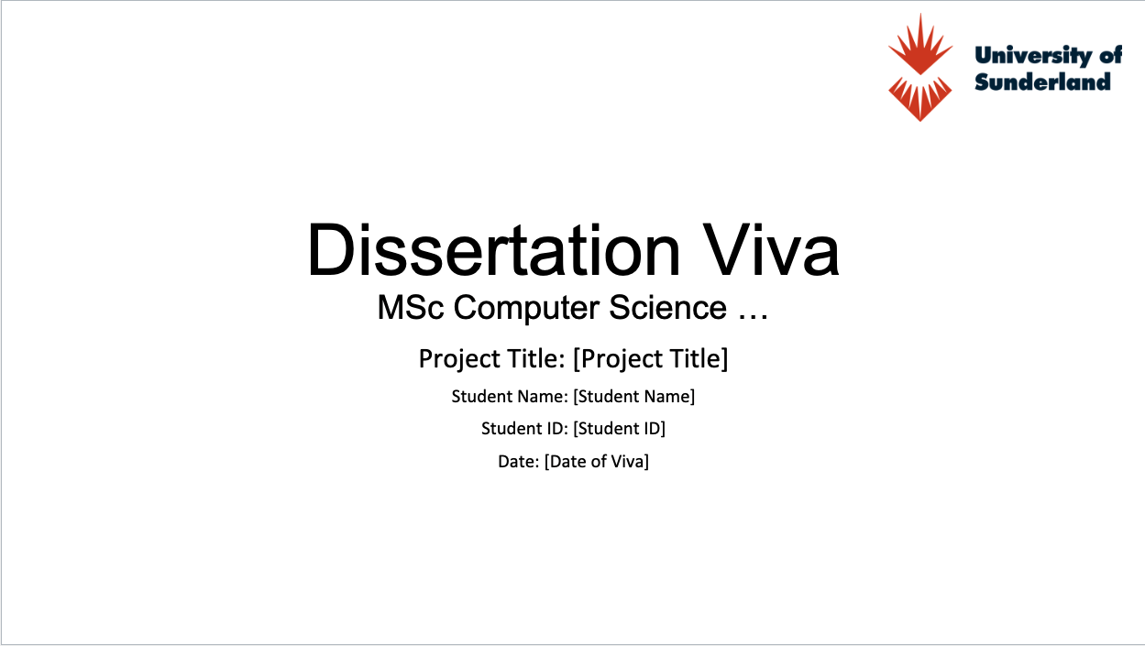
Assignment 3: Viva – Presentation
Top Tips:
Use the Viva template on Canvas
Don’t over complicate slides
Not too much text
Appropriate font size
Use of images / figures
Make them look professional!
Use the key parts from your Dissertation chapters
The supervision team will be looking for consistency between your Viva and Dissertation
When discussing existing literature cite and reference the authors

Slide 31
Assignment 3: Viva - Demo
You will have approximately 5 minutes to demo your practical work
Make sure you have the practical work ready and set up so you don’t waste valuable viva time
Use the time to talk through the most pertinent, technically demanding aspect of the project
Do not spend the 5 minutes talking through the libraries you have used
The supervisory team will be looking for you to demonstrate confidence and competency in your discussion of the technical work

Slide 32
Assignment 3: Viva – Questions
Either during or after your presentation / demo you will be asked questions by the supervisory team that directly related to your project.
They may ask questions about:
The practical work completed
Specific technical questions
Research methodology
Key literature sources
They will also ask about your project management approach, the kind of questions you may be asked include:
How successful were you in achieving the intended objectives for your project?
What approaches did you use to support the management of your project and how effective were these?
Was your approach to integrating the research and practical element appropriate and useful?
Were there tensions, risks, challenges, or issues within your project and if so, how did you deal with them?
What are the key lessons you have learnt about project management from undertaking the project?

Slide 33

General Viva Advice
Be on time to your viva slot
Have your Presentation and Demo ready to go
If your viva is via Teams have your camera on and ensure the audio quality is satisfactory
It’s perfectly normal to be nervous and the supervisory team will understand and be considerate
Take your time to think through your answer to the questions
DO NOT use Google or ChatGPT to generate a response to the viva questions
Be clear and concise in your answer
Feel free to ask the supervisor to repeat a question or explain it further if you’re unsure what they are asking
If you don’t know the answer, be honest and say so

Slide 34
Questions?

